Slide 1
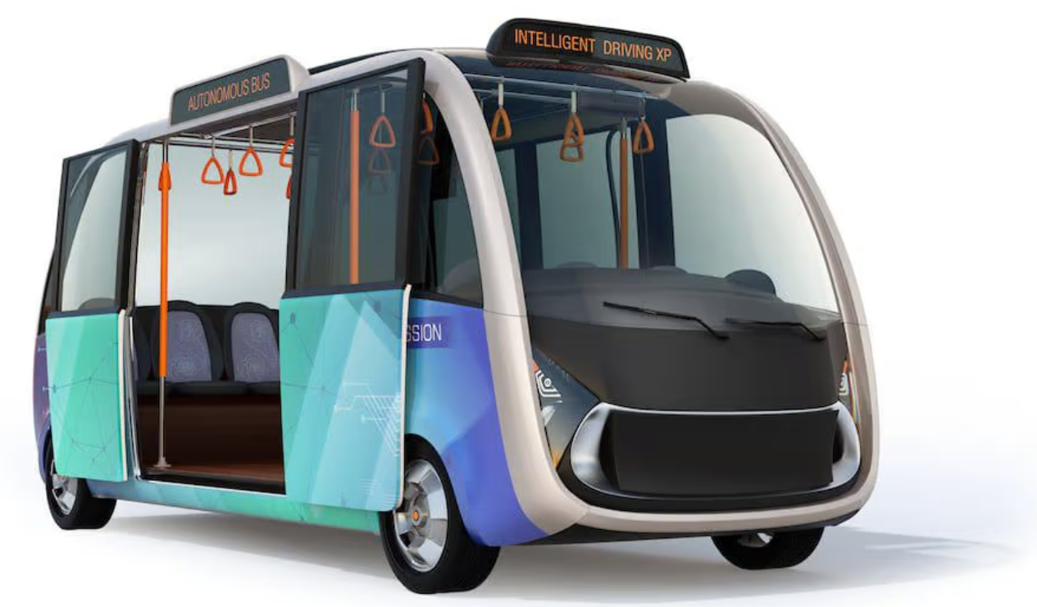
Open Tunnel Alliance
A Competitive
Autonomous Transportation System
Open specifications provide open access

Slide 2
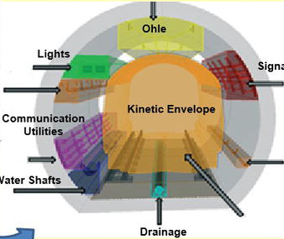
What is the Open Tunnel Alliance
An set of standards used by different autonomous vehicles
Enables street-based robotaxis to use tunnels
Specifies physical dimensions, functions & base requirements

Slide 3
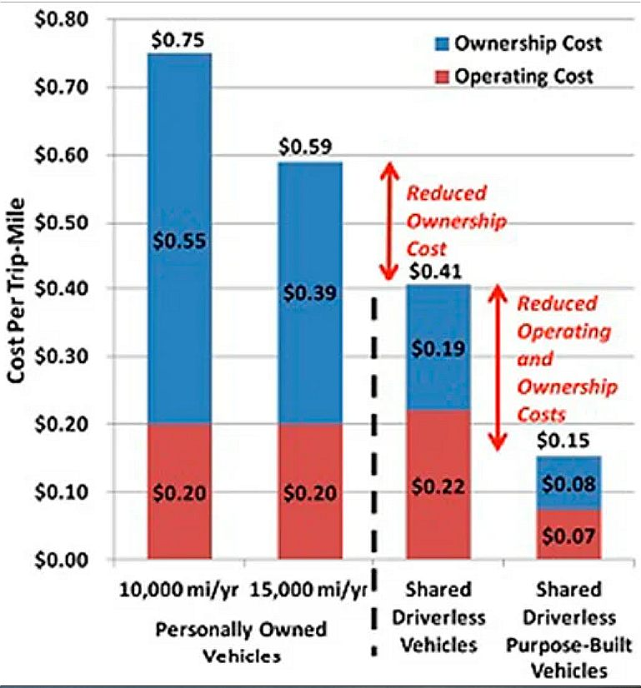
PURPOSE of the Open Tunnel Alliance
Provides a competitive environment
Enables cities to bid on different tunnel elements,
i.e. size, function & cost
Enables different robotaxis to use a “standard” tunnel
Lowers cost. Increases competition.

Slide 4
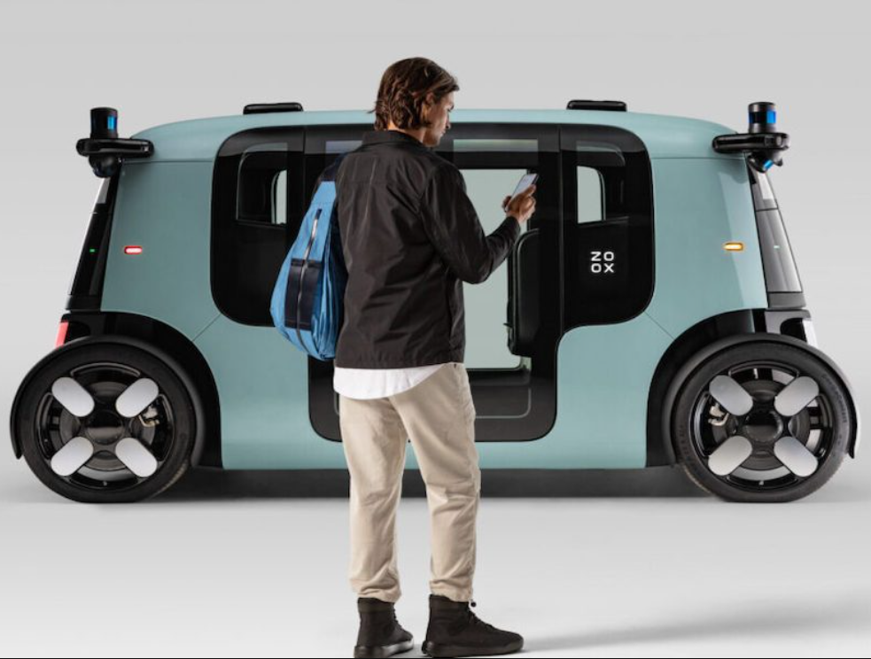
The Open Tunnel Alliance: NEED
Currently ONLY Musk’s vehicles can use their tunnel
Accomodates competitive
6-12 passenger EV shuttles
Largest tunnels accomodate autonomous trucks
Open specifications enable interoperablity & competition

Slide 5
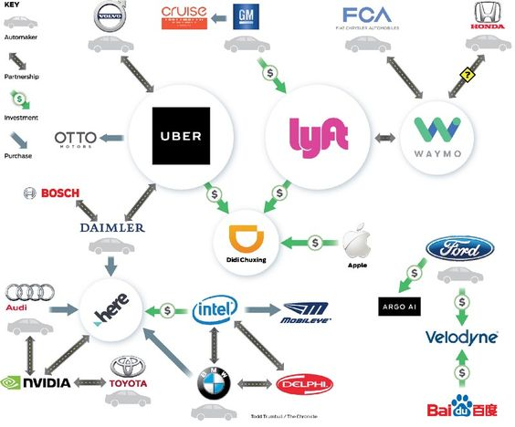
Autonomous Shuttles have ARRIVED
GM & Honda's Cruise
Ford & VW with Argo
Lyft and Motional
Amazon's Zoox
Google's Waymo
Aurora & Volvo trucks
Waymo & Daimler trucks

Slide 6
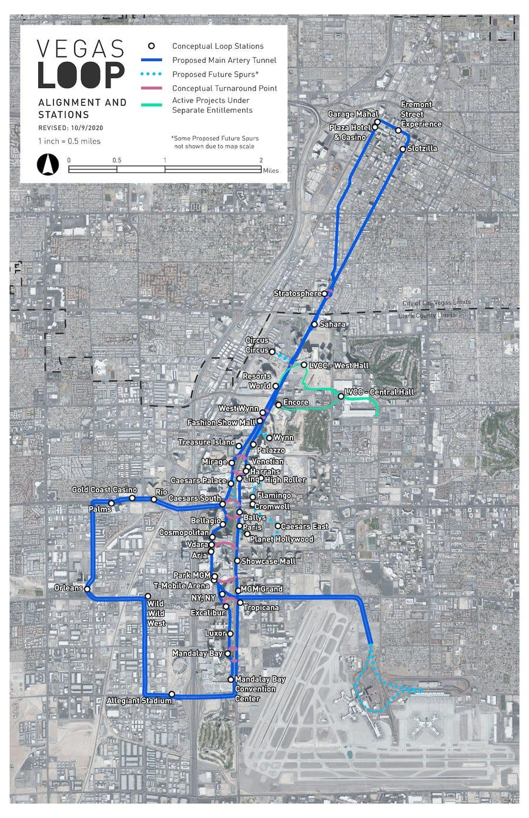
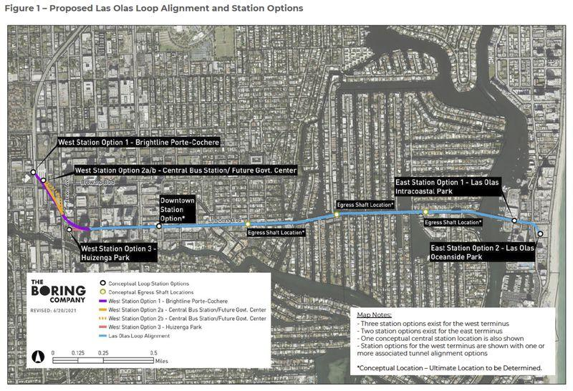
Musk Tunnels planned for NV & FL
Las Vegas: 29 mile network of tunnels with 51 stations. Transport as many as 57,000 passengers per hour.
Ft. Lauderdale
Two, 2.7 mile tunnels with
cars traveling 50-70mph. Cost estimated at $5 one way.

Slide 7
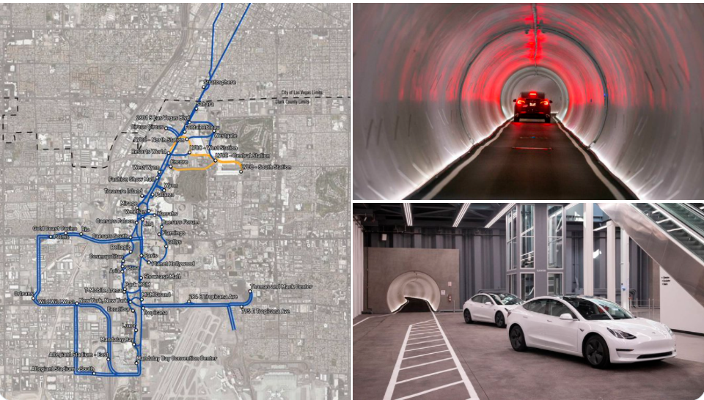
Disadvantages of Musk Tunnels
ONLY Tesla vehicles allowed
Tunnel travel only
Street shuttles have no access
Monopoly control
No competitive bidding

Slide 8
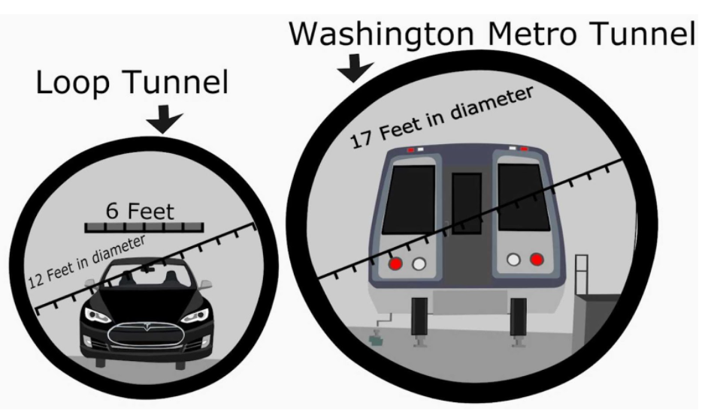
Open Tunnel GOALS
Open. Industry standards
define ALL specifications for tunnel interoperability
Modular. ANY vehicle that meets the interface spec may operate
Interoperable. Different robotaxis can use different sized tunnels
Competitive. More providers enable lower cost

Slide 9
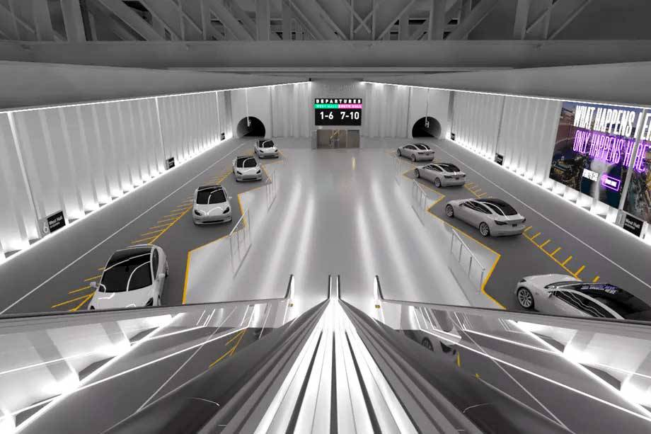
Proposed Portland Tunnel
Tunnel between Expo Center & Lloyd Center
Vancouver connection direct via bridge or BRT
No stops (like Max). No I-5 congestion (like BRT)
No tolls. Faster. Cheaper.

Slide 10
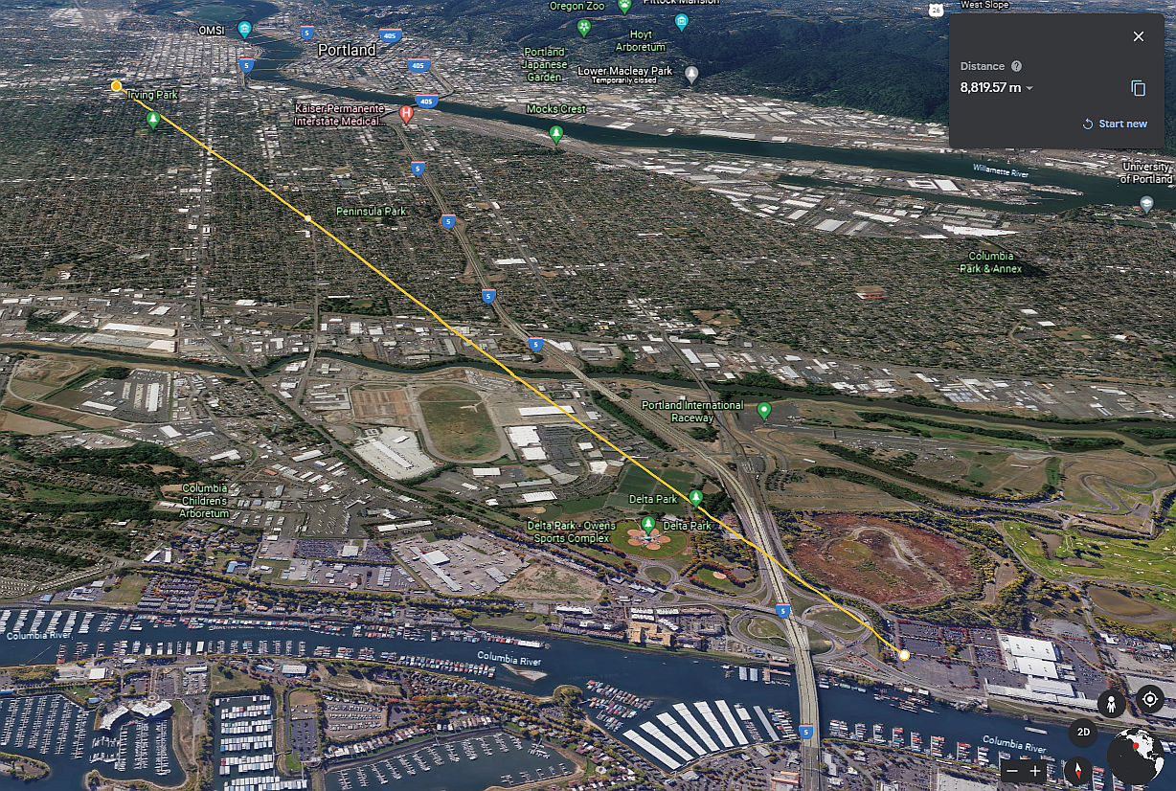
Portland Tunnel Alignment
Expo to Lloyd Center Tunnel approx 10 miles
At $20M/mile, two tunnels cost about $200M to drill.
Est. $800M total for tunnel with 3 terminals and 20 vehicles.
No stops. No tolls. No Congestion.
Faster. Cheaper.

Slide 11
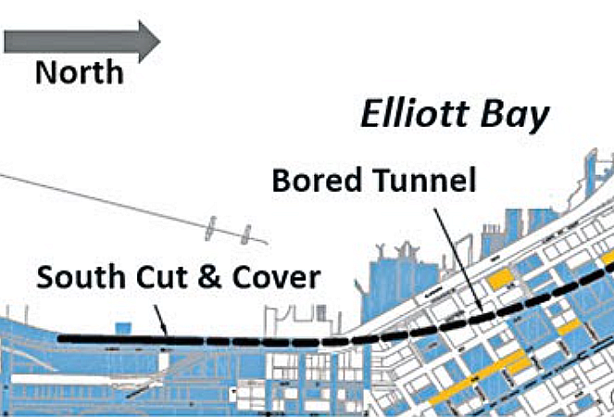
Advantages of Tunnel over IBR
Half price (~$2B). Est. $1.2B for new bridge, plus $800M for EV Tunnel
Reducted Congestion
No stops (like Max). No I-5 congestion (like BRT)
Robotaxis can deliver you direct to final destination.

Slide 12
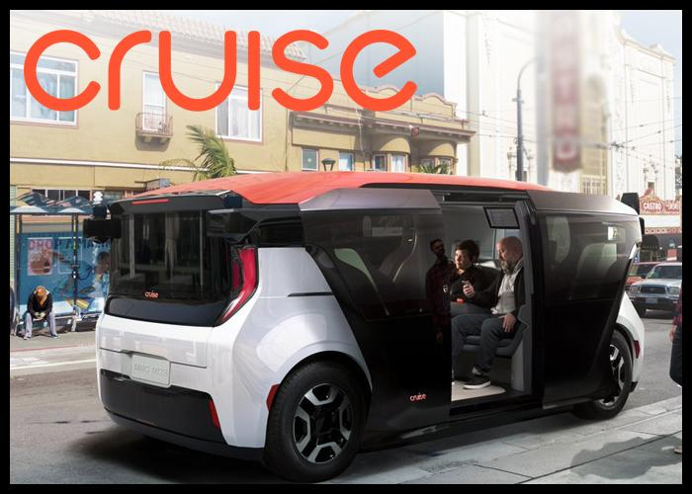
Autonomy is Real
The US autonomous car market is consolidating with Waymo, Tesla, GM, Ford, Honda, Nissan, Daimler, Amazon, Uber and Lyft leading the pack.
More than 1,400 self-driving cars and trucks are being tested by more than 80 companies across 36 US states. Lyft and Aptiv have provided 100,000 commercial robotaxi rides, with 98% of these paying passengers giving five stars to their self-driving ride experience.

Slide 13
Conclusion
Autonomous transportation systems are here.
No pollution. No congestion.
Cheaper. Faster.
No tolls. No mileage fees.
The Open Tunnel Alliance provides robust competition.
The DOTs and Transit agenies hate this idea. Let’s talk. A solution that benefits everyone is the goal.

Slide 14
Thank you!
Author Sam Churchill is a Hayden Island resident
schurchill@gmail.com hayden-island.com
Reference Links:
waymo.com
getcruise.com
argo.ai
aurora.tech
Motional.com
zoox.com/
tesla.com/autopilot
daimler-trucksnorthamerica.com/autonomous
boringcompany.com
tunneltalk.com
newcivilengineer.com/subject/tunnels
en.wikipedia.org/wiki/Tunnel_boring_machine
Autonomous transportation systems are here.
The Open Tunnel Alliance provides robust competition.
A solution that benefits everyone is the goal.

